Slide 1
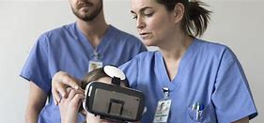
Emergency management/search and rescue

Slide 2
Contents
What is augmented reality ?
How usualy augmented reality ?

Slide 3
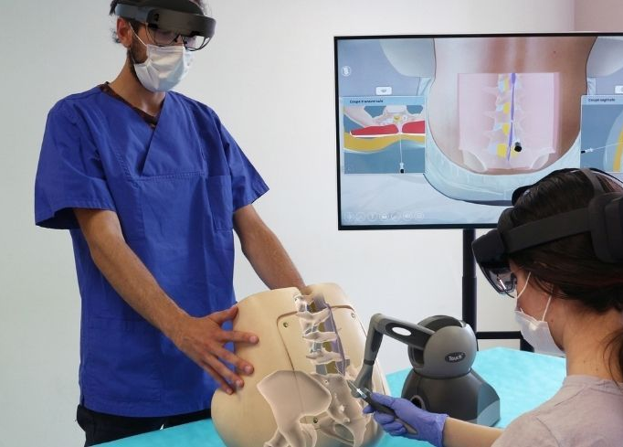
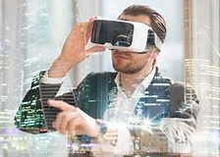
What is Augmented Reality ?
Technological equipment
Virtual world

Slide 4
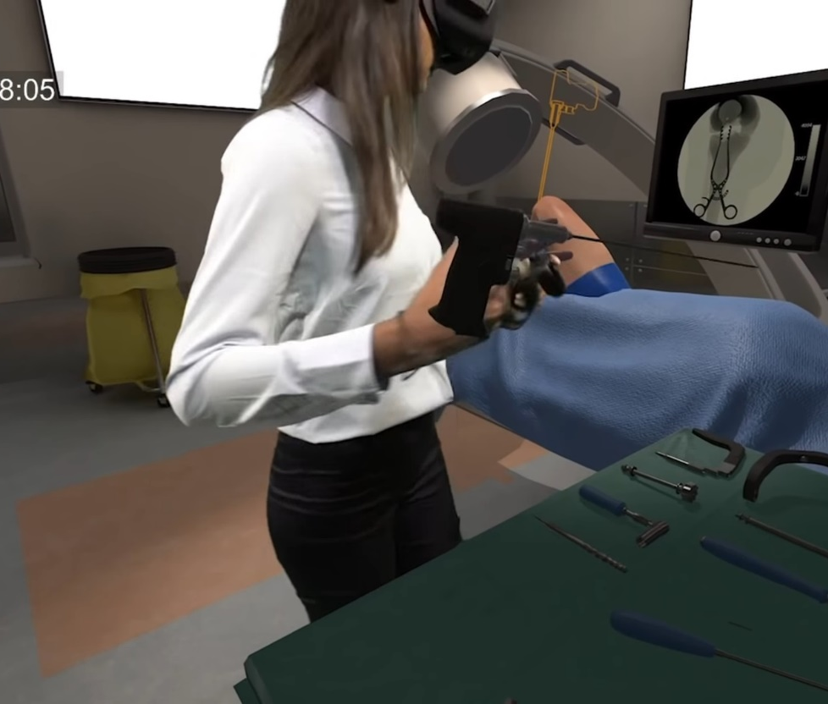
How he uses augmented reality in emergency ?
Training
Therapy
Re-education

Slide 5
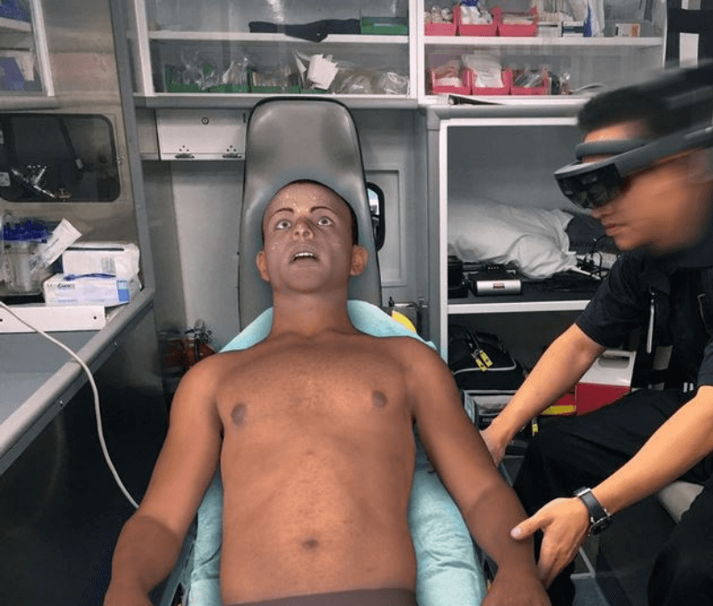
What’s the advantages of augmented reality in emergency ?
Distance care
Efficient
Business

Slide 6
End Thank you for being attentive

